Slide 1
Experimental Fleet ManagEMent
Saleh Ahmed Panna

Slide 2
The Problem
What is the problem?
Merging data from remote api in a scheduled manner
Who has this problem?
AiSight
Why should this problem be solved?
Automates data import and presents in chart
Updates data automatically
How will I know this problem has been solved?

Slide 3
Background Information
What is your research?
The problem is found from a mail for job interview
The pdf attached with the mail asked to solve the problem of automating the importing of simulated cars.

Slide 4
Workable Solutions
Solution #1
Bulk import
Solution #2
Merging of vehicles one at a time
Easy and achievable in short time
Requires experiments and time
Will take less time if there are lots of vehicles.
Will take more time

Slide 5
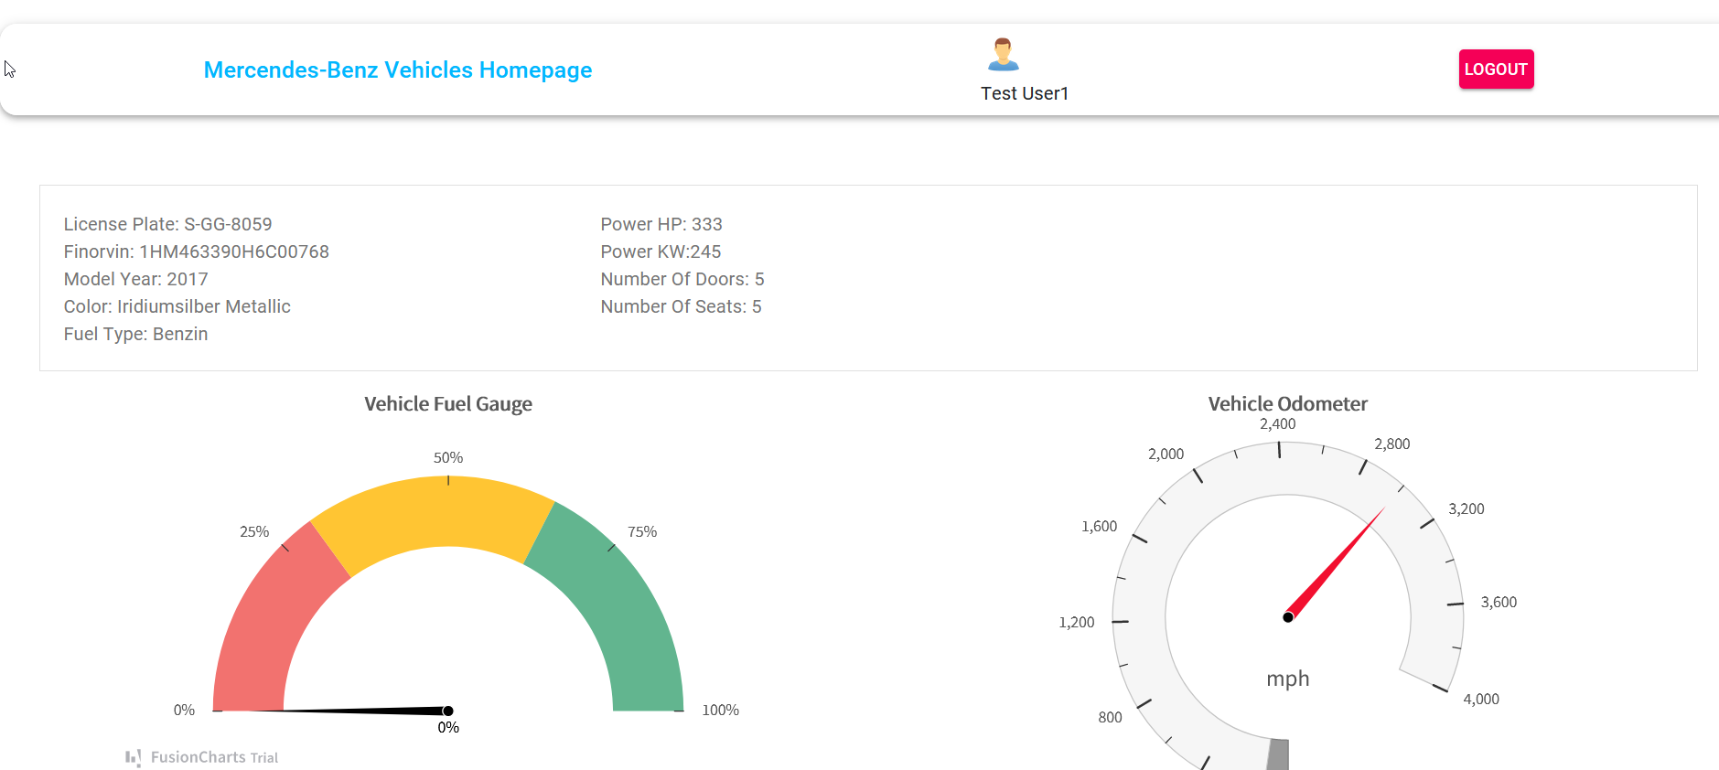
The Prototype
Here we are going with solution#2
Node.js, React.js, MongoDB is used
This solution can be refactored to bigger project
<Insert a picture or drawing of your prototype here>

Slide 6
Testing The Prototype
The solution considers happy path only. The error handling could be made better.
Used Fusion chart trial version which can be changed to a open source ChartJS later and also deprecated package like request used in nodejs also need changing.
Browser opens up automatically when we are starting nodejs. This is required for authentication to Mercedes api.

Slide 7
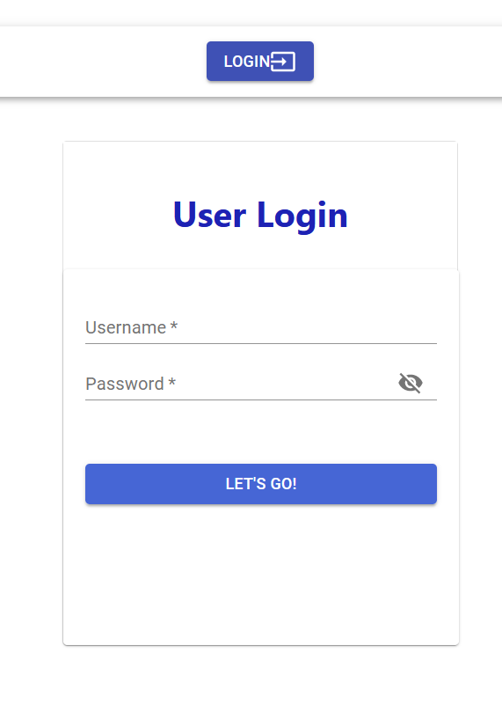
Login Screen
Some builtin users are already in the database. Use the following credentials.
Username: Test User1
Password: test1

Slide 8
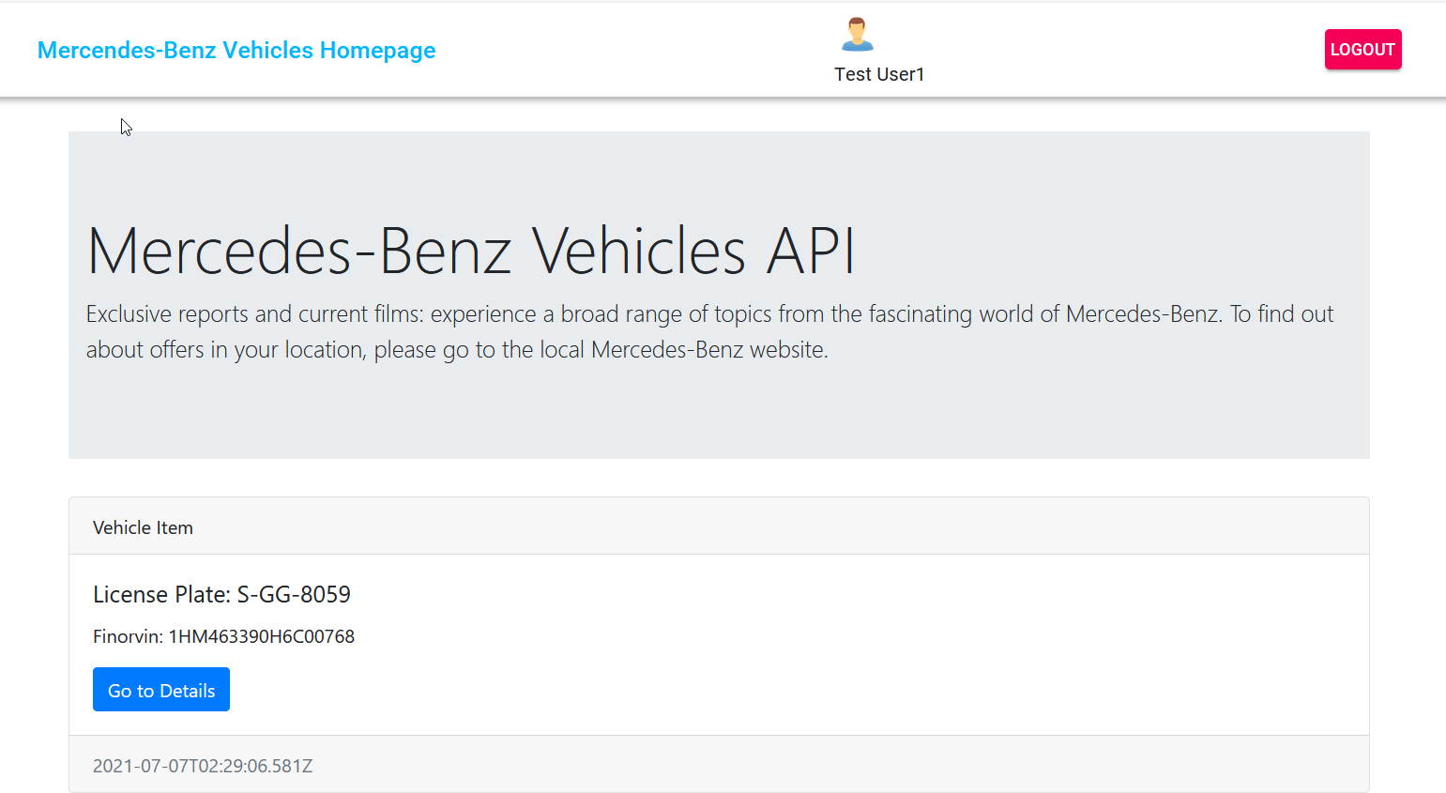
Home Screen

Slide 9
Details Screen

Slide 10
Final Result
This solves the problem of scheduled import of data.
I feel lots of error handling and load testing was needed.

